Slide 1

Ossama Taha
5.3.2024

Slide 2

Outline
Executive Summary
Introduction
Methodology
Results
Conclusion
Appendix

Slide 3
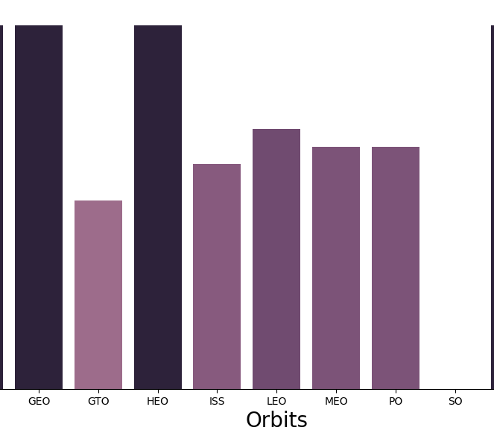
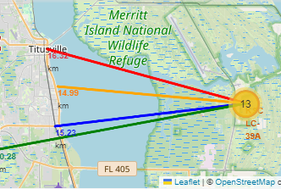
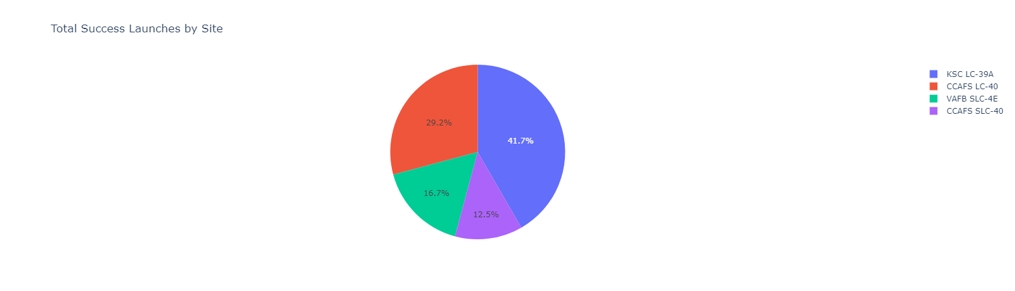
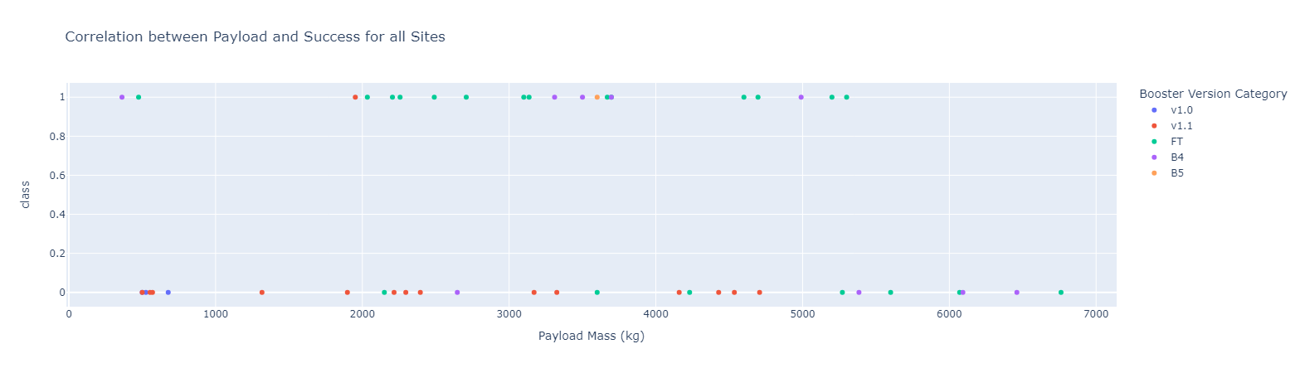

Executive Summary
Summary of methodologies
This project follows these steps:
Data Collection
Data Wrangling
Exploratory Data Analysis
Interactive Visual Analytics
Predictive Analysis (Classification)
Summary of all results
This project produced the following outputs and visualizations:
Exploratory Data Analysis (EDA) results
Geospatial analytics
Interactive dashboard
Predictive analysis of classification models

Slide 4

Introduction
SpaceX launches Falcon 9 rockets at a cost of around $62m. This is considerably cheaper than other providers (which usually cost upwards of $165m), and much of the savings are because SpaceX can land, and then re-use the first stage of the rocket.
If we can make predictions on whether the first stage will land, we can determine the cost of a launch, and use this information to assess whether or not an alternate company should bid and SpaceX for a rocket launch.
This project will ultimately predict if the Space X Falcon 9 first stage will land successfully.

Slide 5

Section 1

Slide 6
Methodology
Data Collection
Making GET requests to the SpaceX REST API
Web Scraping
Data Wrangling
Using the .fillna() method to remove NaN values
Using the .value_counts() method to determine the following:
Number of launches on each site
Number and occurrence of each orbit
Number and occurrence of mission outcome per orbit type
Creating a landing outcome label that shows the following:
0 when the booster did not land successfully
1 when the booster did land successfully
Exploratory Data Analysis
Using SQL queries to manipulate and evaluate the SpaceX dataset
Using Pandas and Matplotlib to visualize relationships between variables, and determine patterns
Interactive Visual Analytics
Geospatial analytics using Folium
Creating an interactive dashboard using Plotly Dash
Data Modelling and Evaluation
Using Scikit-Learn to:
Pre-process (standardize) the data
Split the data into training and testing data using train_test_split
Train different classification models
Find hyperparameters using GridSearchCV
Plotting confusion matrices for each classification model
Assessing the accuracy of each classification model

Slide 7

Data Collection
Data Sources:
SpaceX API:
Utilized SpaceX’s public API to retrieve real-time and historical data.
Gathered information on rocket launches, payloads, missions, and other relevant details.
Web Scraping (Wikipedia):
Extracted data from Wikipedia pages related to space missions.
Focused on SpaceX-specific entries, mission details, and relevant context.
Data Collection Methods:
API Integration:
Connected to SpaceX’s API endpoints using appropriate endpoints (e.g., /launches, /rockets).
Retrieved data in structured formats (JSON, XML, etc.).
Web Scraping:
Identified relevant Wikipedia pages (e.g., “SpaceX launches,” “Falcon 9,” etc.).
Extracted text, tables, and relevant data points.
Cleaned and transformed the scraped data.

Slide 8
Data Collection – SpaceX API
Present your data collection with SpaceX REST calls using key phrases and flowcharts
Add the GitHub URL of the completed SpaceX API calls notebook (must include completed code cell and outcome cell), as an external reference and peer-review purpose
Place your flowchart of SpaceX API calls here

Slide 9
Data Collection - Scraping
Present your web scraping process using key phrases and flowcharts
Add the GitHub URL of the completed web scraping notebook, as an external reference and peer-review purpose
Place your flowchart of web scraping here

Slide 10
Data Wrangling
Describe how data were processed
You need to present your data wrangling process using key phrases and flowcharts
Add the GitHub URL of your completed data wrangling related notebooks, as an external reference and peer-review purpose

Slide 11
EDA with Data Visualization
Summarize what charts were plotted and why you used those charts
Add the GitHub URL of your completed EDA with data visualization notebook, as an external reference and peer-review purpose

Slide 12
EDA with SQL
Using bullet point format, summarize the SQL queries you performed
Add the GitHub URL of your completed EDA with SQL notebook, as an external reference and peer-review purpose

Slide 13
Build an Interactive Map with Folium
Summarize what map objects such as markers, circles, lines, etc. you created and added to a folium map
Explain why you added those objects
Add the GitHub URL of your completed interactive map with Folium map, as an external reference and peer-review purpose

Slide 14
Build a Dashboard with Plotly Dash
Summarize what plots/graphs and interactions you have added to a dashboard
Explain why you added those plots and interactions
Add the GitHub URL of your completed Plotly Dash lab, as an external reference and peer-review purpose

Slide 15
Predictive Analysis (Classification)
Summarize how you built, evaluated, improved, and found the best performing classification model
You need present your model development process using key phrases and flowchart
Add the GitHub URL of your completed predictive analysis lab, as an external reference and peer-review purpose

Slide 16
Results
Exploratory data analysis results
Interactive analytics demo in screenshots
Predictive analysis results

Slide 17

Section 2

Slide 18
Flight Number vs. Launch Site
Show a scatter plot of Flight Number vs. Launch Site
Show the screenshot of the scatter plot with explanations

Slide 19
Payload vs. Launch Site
Show a scatter plot of Payload vs. Launch Site
Show the screenshot of the scatter plot with explanations

Slide 20
Success Rate vs. Orbit Type
Show a bar chart for the success rate of each orbit type
Show the screenshot of the scatter plot with explanations

Slide 21
Flight Number vs. Orbit Type
Show a scatter point of Flight number vs. Orbit type
Show the screenshot of the scatter plot with explanations

Slide 22
Payload vs. Orbit Type
Show a scatter point of payload vs. orbit type
Show the screenshot of the scatter plot with explanations

Slide 23
Launch Success Yearly Trend
Show a line chart of yearly average success rate
Show the screenshot of the scatter plot with explanations

Slide 24
All Launch Site Names
Find the names of the unique launch sites
Present your query result with a short explanation here

Slide 25
Launch Site Names Begin with 'CCA'
Find 5 records where launch sites begin with `CCA`
Present your query result with a short explanation here

Slide 26
Total Payload Mass
Calculate the total payload carried by boosters from NASA
Present your query result with a short explanation here

Slide 27
Average Payload Mass by F9 v1.1
Calculate the average payload mass carried by booster version F9 v1.1
Present your query result with a short explanation here

Slide 28
First Successful Ground Landing Date
Find the dates of the first successful landing outcome on ground pad
Present your query result with a short explanation here

Slide 29
Successful Drone Ship Landing with Payload between 4000 and 6000
List the names of boosters which have successfully landed on drone ship and had payload mass greater than 4000 but less than 6000
Present your query result with a short explanation here

Slide 30
Total Number of Successful and Failure Mission Outcomes
Calculate the total number of successful and failure mission outcomes
Present your query result with a short explanation here

Slide 31
Boosters Carried Maximum Payload
List the names of the booster which have carried the maximum payload mass
Present your query result with a short explanation here

Slide 32
2015 Launch Records
List the failed landing_outcomes in drone ship, their booster versions, and launch site names for in year 2015
Present your query result with a short explanation here

Slide 33
Rank Landing Outcomes Between 2010-06-04 and 2017-03-20
Rank the count of landing outcomes (such as Failure (drone ship) or Success (ground pad)) between the date 2010-06-04 and 2017-03-20, in descending order
Present your query result with a short explanation here

Slide 34

Section 3

Slide 35
<Folium Map Screenshot 1>
Replace <Folium map screenshot 1> title with an appropriate title
Explore the generated folium map and make a proper screenshot to include all launch sites’ location markers on a global map
Explain the important elements and findings on the screenshot

Slide 36
<Folium Map Screenshot 2>
Replace <Folium map screenshot 2> title with an appropriate title
Explore the folium map and make a proper screenshot to show the color-labeled launch outcomes on the map
Explain the important elements and findings on the screenshot

Slide 37
<Folium Map Screenshot 3>
Replace <Folium map screenshot 3> title with an appropriate title
Explore the generated folium map and show the screenshot of a selected launch site to its proximities such as railway, highway, coastline, with distance calculated and displayed
Explain the important elements and findings on the screenshot

Slide 38

Section 4

Slide 39
<Dashboard Screenshot 1>
Replace <Dashboard screenshot 1> title with an appropriate title
Show the screenshot of launch success count for all sites, in a piechart
Explain the important elements and findings on the screenshot

Slide 40
<Dashboard Screenshot 2>
Replace <Dashboard screenshot 2> title with an appropriate title
Show the screenshot of the piechart for the launch site with highest launch success ratio
Explain the important elements and findings on the screenshot

Slide 41
<Dashboard Screenshot 3>
Replace <Dashboard screenshot 3> title with an appropriate title
Show screenshots of Payload vs. Launch Outcome scatter plot for all sites, with different payload selected in the range slider
Explain the important elements and findings on the screenshot, such as which payload range or booster version have the largest success rate, etc.

Slide 42

Section 5

Slide 43
Classification Accuracy
Visualize the built model accuracy for all built classification models, in a bar chart
Find which model has the highest classification accuracy

Slide 44
Confusion Matrix
Show the confusion matrix of the best performing model with an explanation

Slide 45
Conclusions
Point 1
Point 2
Point 3
Point 4
…

Slide 46
Appendix
Include any relevant assets like Python code snippets, SQL queries, charts, Notebook outputs, or data sets that you may have created during this project

Slide 47


